Slide 1
Why Hotel Guests Cancel
SCTP ASSOCIATE DATA ANALYST CAPSTONE
Booking cancellation analysis for a City Hotel and a Resort Hotel
Kelvin Chu | 3rd Nov 2026
Notes:
About 30 seconds
- Greet the assessor.
- Project 14.1 Hotel Bookings.
- Question: why do guests cancel and how much revenue is at risk?
- Data from a City Hotel and a Resort Hotel.
- Python in Google Colab to clean and analyse. Power BI for the dashboard.

Slide 2
Cancellations cost hotels revenue
THE PROBLEM
Hotels lose revenue when guests cancel their bookings. A cancelled room that is not resold earns nothing.
Empty rooms
Hard to plan
Overbooking guesswork
Late cancellations leave rooms unsold.
Staff and supplies are planned for guests who do not arrive.
Without data managers cannot set safe overbooking levels.
Hotel managers need to know when and why guests cancel and how much revenue is at risk.
Notes:
About 1 minute
- Hotels lose money when guests cancel.
- A room that is not resold earns nothing.
- Staff, supplies and meals are planned for guests who do not come.
- Without data, managers can only guess how much to overbook.
- So the questions are: when and why do guests cancel, and how much revenue is at risk?

Slide 3
5 questions the analysis answers
RESEARCH OBJECTIVES
1
Measure booking volume and cancellation rate by hotel, month and season.
2
Compare average daily rate and length of stay between the 2 hotels across the year.
3
Identify the booking factors linked to higher cancellation rates.
4
Examine how guest profile and history relate to cancellations.
5
Estimate the revenue lost to cancellations and how far ahead of arrival guests cancel.
Notes:
About 45 seconds
- 5 research objectives, all descriptive.
- Objectives 1 and 2: demand and price.
- Objectives 3 and 4: booking factors and guest factors linked to cancellation.
- Objective 5: the value of the loss and how much time the hotel has to resell a room.

Slide 4
From raw files to a refreshable dashboard
DATA AND APPROACH
119,390
2
26
5
bookings in the raw data
hotels: City Hotel and Resort Hotel
months: July 2015 to August 2017
CSV files: 1 bookings table and 4 lookup tables
1
2
3
4
GitHub
Google Colab
Clean file
Power BI
Stores the 5 raw CSV files
Loads, cleans and analyses the data in 1 notebook
hotel_clean.csv saved back to GitHub
Reads the clean file by link for a 3-page dashboard
Notes:
About 1 minute
- 119,390 bookings from 2 hotels over 26 months.
- 5 CSV files: 1 bookings table and 4 small lookup tables joined by ID.
- All files are stored on GitHub.
- The Colab notebook loads them straight from GitHub, then cleans and analyses them.
- The clean file is saved back to GitHub.
- Power BI reads the clean file by its link, so 1 click on Refresh loads new data.

Slide 5
14 data issues found and fixed
DATA PREPARATION
Issue found | What was done | Why
Blank children, country and agent | Filled with 0, Unknown and 0 | A blank means none, so no booking had to be dropped
Company 94% blank | Dropped, kept a yes/no flag | Too empty to use, but the flag keeps the useful part
180 bookings with no guests | Removed | A real booking must have at least 1 guest
ADR below 0 or 5,400 | Removed as errors | A price cannot be negative. 5,400 is 10 times the next
Undefined segment or channel | Removed (5 bookings) | Too few to analyse and no meaning for managers
Meal codes SC and Undefined | Merged into No meal | Both codes mean no meal package was booked
Arrival date split over 3 columns | Built 1 arrival date | Needed for monthly trends and cancellation timing
33,010 rows identical except ID | Kept for the analysis | Likely group bookings. Removed only for the model
187 rows removed in total (0.2% of bookings). 10 new columns created, such as total nights and room revenue.
Notes:
About 1 minute 30 seconds
Opening
- Checked every table for problems before any analysis.
- Logged 14 issues in the notebook. Main ones in 3 groups.
Group 1: blanks
- Children, country and agent had blanks.
- A blank means none, so filled with 0 or Unknown. No booking deleted.
- Company was 94% blank: dropped it, kept a yes/no flag.
Group 2: invalid rows
- 180 bookings had no guests, so not real bookings. Removed.
- 2 impossible prices: 1 below 0 and 1 at 5,400 (next highest is 510). Removed.
- 5 bookings with Undefined segment or channel. Too few to analyse. Removed.
- Total 187 rows = only 0.2% of the data, so results are not affected.
Group 3: labels and dates
- Meal codes SC and Undefined both mean no meal package. Merged into No meal.
- Arrival date was split over 3 columns. Built 1 proper date.
- Needed for monthly trends and days cancelled before arrival.
Duplicates
- 33,010 rows look the same apart from the booking ID.
- Most likely several rooms in 1 group booking, so kept for the analysis.
- Removed only for the model, so the same booking is not in both training and test data.
Close
- Also created 10 new columns, such as total nights, room revenue and days cancelled before arrival.

Slide 6
THE HEADLINE
37.1%
of bookings were cancelled or did not show up
16.7 million
39.2%
41.8% vs 27.8%
room revenue in cancelled bookings
of all booked room revenue
City Hotel vs Resort Hotel
Notes:
About 30 seconds
- More than 1 in 3 bookings (37.1%) were cancelled or did not show up.
- Those bookings were worth 16.7 million in room revenue.
- That is 39.2% of everything booked.
- City Hotel has the bigger problem: 41.8% vs 27.8% at the Resort Hotel.
- Note: this is the room value of cancelled bookings. Some rooms were resold, so the real loss is lower.

Slide 7
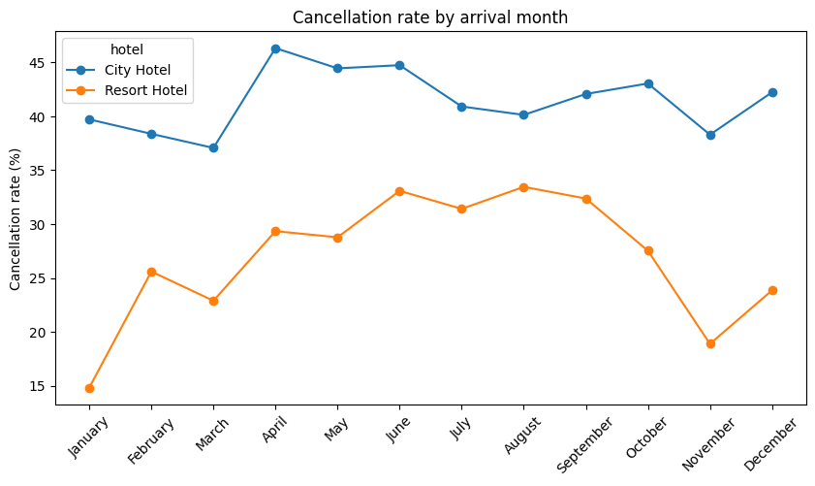
Both hotels peak in summer
OBJECTIVE 1 | VOLUME AND CANCELLATION RATE
41.8%
City Hotel cancellation rate. It stays between 37% and 46% all year.
27.8%
Resort Hotel cancellation rate
14.8% to 33.4%
Resort Hotel rate from January to August
Notes:
About 45 seconds
- Both hotels are busiest in summer.
- City Hotel cancels a high share all year: between 37% and 46%.
- Resort Hotel is lower on average at 27.8%.
- But the Resort rate more than doubles: 14.8% in January to 33.4% in August.
- So summer is also the riskiest time for the Resort Hotel.

Slide 8
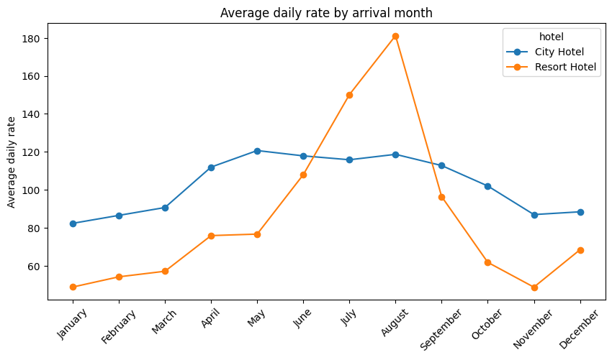
Resort prices almost 4 times higher in summer
OBJECTIVE 2 | PRICE AND LENGTH OF STAY
49 to 181
Resort Hotel average daily rate from January to August
82 to 121
City Hotel average daily rate across the year
4.14 vs 2.92
nights per stay: Resort Hotel vs City Hotel
Notes:
About 45 seconds
- ADR = average daily rate, the average price per room per night.
- Resort Hotel prices are very seasonal: about 49 in January, 181 in August.
- That is almost 4 times higher in summer.
- City Hotel prices are steadier: 82 to 121.
- Resort guests stay longer: 4.14 nights vs 2.92.
- So a cancelled summer booking at the Resort Hotel is worth the most.

Slide 9
Bookings made far ahead cancel most
OBJECTIVE 3 | BOOKING FACTORS
99.4%
of Non Refund deposit bookings cancel
61.1% vs 15.4%
Groups vs Direct bookings
40.8%
Transient guests, the highest of the 4 customer types
Notes:
About 1 minute
- Lead time is the strongest booking factor.
- Booked within a week: 9.6% cancel. Booked over a year ahead: 67.7% cancel.
- That is about 7 times more often.
- Surprise: 99.4% of Non Refund deposit bookings cancel.
- Almost all are groups and offline travel agents. They likely hold rooms and release unsold ones.
- The data cannot confirm the reason.
- Groups cancel 61.1% vs 15.4% for direct bookings.

Slide 10
Loyal and engaged guests cancel less
OBJECTIVE 4 | GUEST PROFILE AND HISTORY
14.7% vs 37.8%
91.7%
Repeat guests vs new guests
of guests who cancelled before cancel again
22.0% vs 47.8%
56.7%
Guests with 1 special request vs no requests
of guests from Portugal cancel. Most foreign guests cancel under 25%
Blue = lower risk. Orange = higher risk.
Notes:
About 45 seconds
- Repeat guests cancel 14.7% vs 37.8% for new guests.
- Guests who cancelled before cancel again 91.7% of the time.
- 1 special request: 22.0% cancel. No requests: 47.8%.
- A request shows the guest plans to come.
- Local guests from Portugal cancel 56.7%. Most foreign guests under 25%.

Slide 11
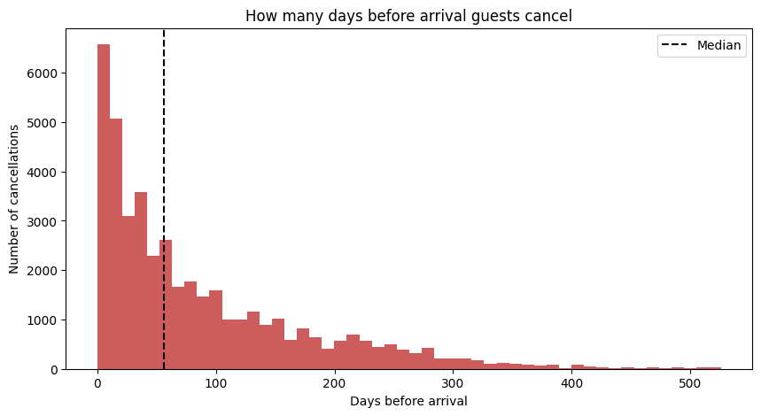
Online travel agents drive most of the loss
OBJECTIVE 5 | REVENUE LOST AND TIMING
16.7M vs 26.0M
room revenue lost vs earned
10.2M
lost from Online travel agent bookings, the largest segment
3.0M
lost in August, the worst month
Median 56 days before arrival. 11.9% of cancellations come in the last week.
Notes:
About 1 minute
- Cancelled bookings worth 16.7 million vs 26.0 million earned.
- Online travel agents make up 10.2 million of the loss.
- August is the worst month at 3.0 million: prices and bookings both highest.
- Chart shows when guests cancel.
- Half cancel more than 56 days before arrival: time to resell.
- But 11.9% cancel in the last week: hardest to resell.

Slide 12
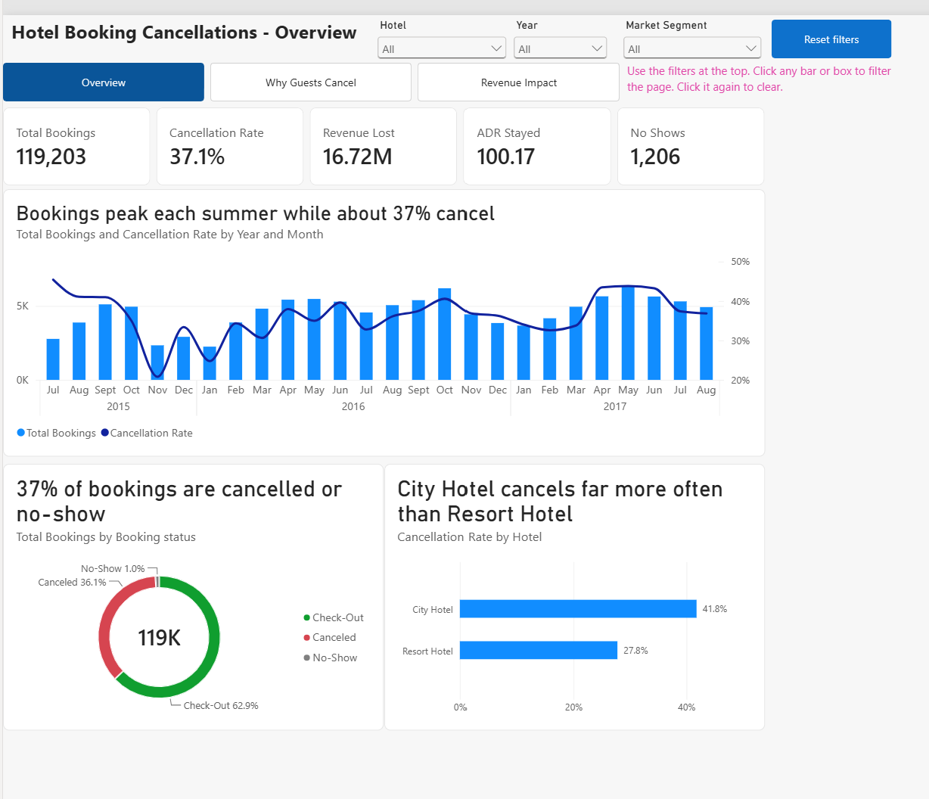
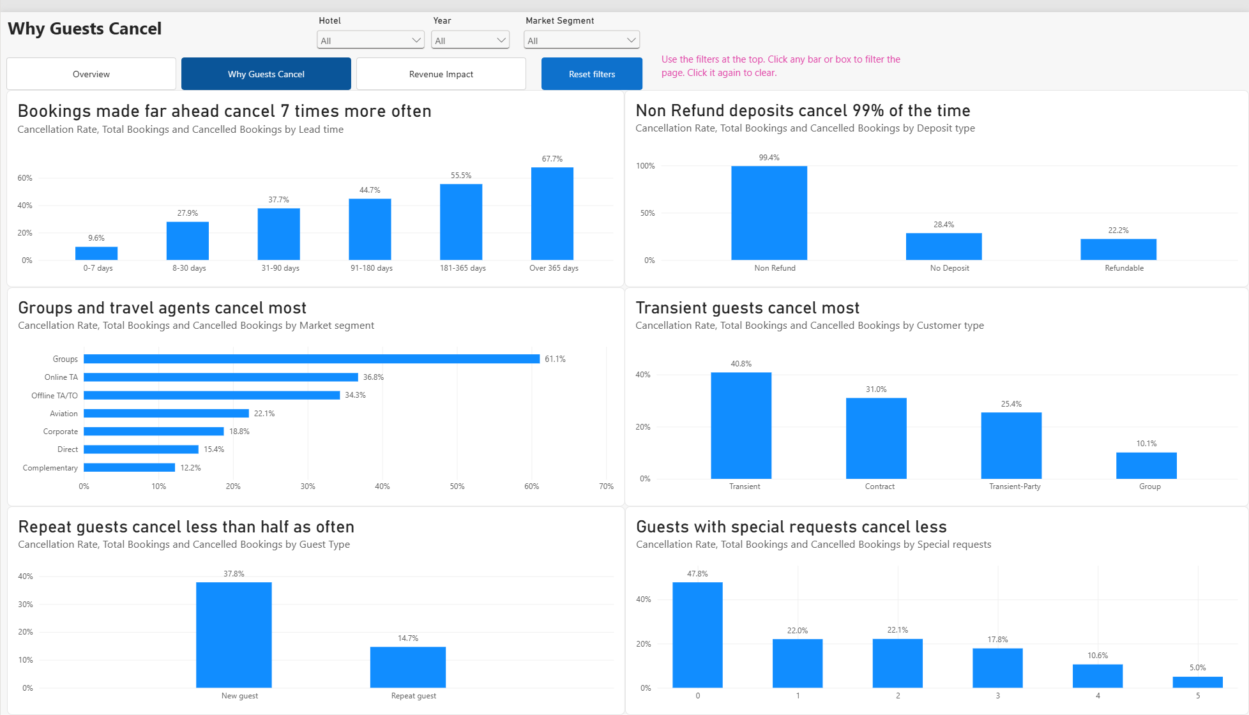
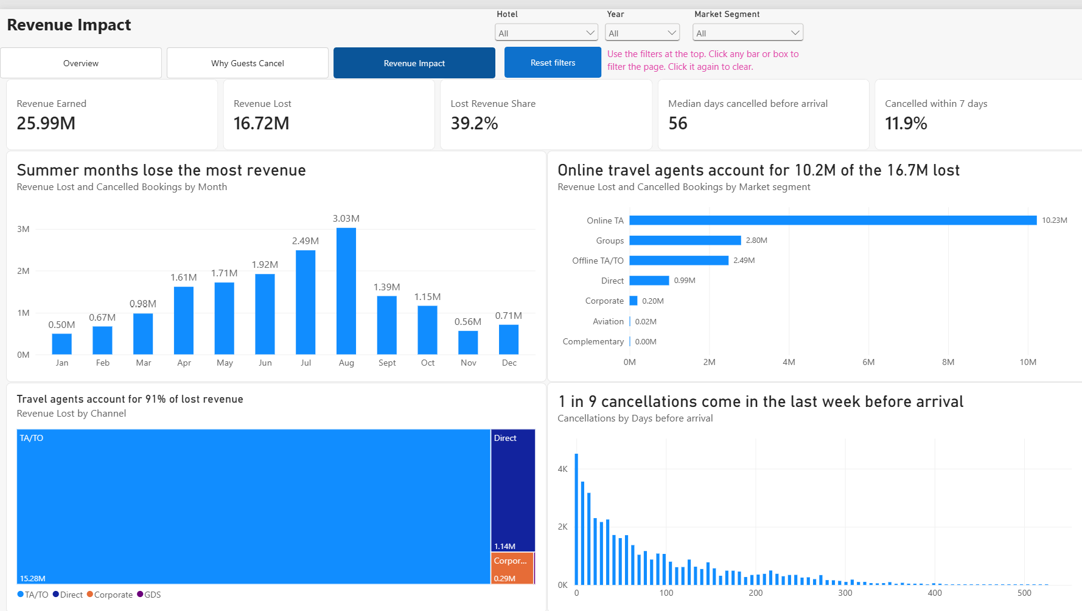
A 3-page dashboard for hotel managers
POWER BI DASHBOARD | LIVE DEMO
Overview
Why Guests Cancel
Revenue Impact
How big is the problem and when does it happen
Which booking and guest factors drive cancellations
Where revenue is lost and how far ahead guests cancel
Filters synced across pages
Page buttons
Reset filters button
Click any bar to filter
Tooltips with booking counts
Notes:
About 2 minutes 45 seconds - switch to Power BI Desktop
1. Overview
- Point to the 5 cards.
- Choose City Hotel in the Hotel filter: cancellation rate changes to 41.8%.
2. Why Guests Cancel
- Click the page button. The filter follows because filters are synced.
- Show the lead time chart.
- Click the Groups bar to filter the page. Click again to clear.
3. Revenue Impact
- Click TA/TO in the treemap: every card and chart updates to travel agent bookings.
4. Hover over a bar to show the tooltip with booking counts.
5. Click Reset filters to clear everything.
If asked about speed
- 14 DAX measures do the calculations, not extra columns, so the dashboard stays fast.
- New data loads with 1 click on Refresh.
Return to the slides.

Slide 13
7 actions for hotel managers
RECOMMENDATIONS
Action | Evidence from the analysis
1. Ask for a deposit on bookings made far ahead | Over 90 days ahead: 44.7% to 67.7% cancel
2. Agree release dates with groups and tour operators | Groups cancel 61.1%. Non Refund bookings 99.4%
3. Grow direct bookings | Online TA: 10.2M of 16.7M lost. Direct: 15.4% cancel
4. Remind guests 2 weeks before arrival | 11.9% of cancellations come in the last week
5. Plan overbooking by hotel and season | City 41.8% vs Resort 27.8%. Resort doubles in summer
6. Reward repeat guests and invite special requests | Repeat guests 14.7%. 1 special request 22.0%
7. Ask guests who cancelled before for a deposit | Guests who cancelled before: 91.7% cancel again
Most of these risk factors are known at the time of booking, so managers can act before a room is lost.
Notes:
About 1 minute
- Each action links to a finding.
- Deposits: for bookings made far ahead and guests who cancelled before.
- Release dates for groups and tour operators.
- A benefit for booking direct: direct bookings cancel only 15.4%.
- Reminder 2 weeks before arrival to bring late cancellations forward.
- Overbooking levels that follow each hotel and month.
- Rewards for repeat guests and a prompt for special requests.
- Key point: lead time, channel, deposit type and guest history are all known at booking.

Slide 14
A model can flag 8 in 10 cancellations
PREDICTIVE EXTENSION
Model | Accuracy | Recall | Precision
Baseline (always predict stay) | 71.8% | 0% | -
Logistic Regression | 76.3% | 37.0% | 63.9%
Decision Tree | 78.7% | 53.5% | 64.8%
Random Forest | 79.3% | 46.5% | 70.1%
Random Forest (balanced) | 72.8% | 80.5% | 51.1%
Chosen: Random Forest (balanced)
It catches the most cancellations. A wrong flag only costs a reminder, while a missed cancellation costs an empty room.
Top drivers
Lead time, local guests, special requests and the Online TA segment. These match the dashboard findings.
Recall = share of real cancellations caught. Trained on 66,625 bookings and tested on 16,657 after removing duplicates.
How it could be used
Score each booking when it is made. Flag high-risk bookings for a deposit or a reminder. Retrain every 3 months.
Notes:
About 1 minute
- Extension beyond the 5 objectives: can booking details predict cancellation?
- Baseline: always predicting stay is right 71.8% of the time.
- Standard Random Forest is most accurate (79.3%) but catches under half of cancellations.
- Balanced Random Forest catches 80.5% of cancellations.
- Cost: more false flags. About half of flagged bookings still stay.
- For a hotel a false flag only costs a reminder, so chose the balanced model.
- Top drivers match the dashboard findings.
- Limit: tested once on past bookings, not on new ones.

Slide 15
CONCLUSION
Cancelled bookings made up 39.2% of booked room revenue
The risk is highest for bookings made far ahead, group and travel agent bookings, new guests and the City Hotel.
Data Limitations
Only 2 hotels in Portugal from July 2015 to August 2017
Resold rooms and kept deposits are not recorded, so the real loss is lower
The data does not record why guests cancelled
Thank you. Questions?
github.com/ahchu2525/capstone-hosp
Notes:
About 45 seconds
- Cancelled bookings made up 39.2% of booked room revenue.
- Highest risk: bookings made far ahead, group and travel agent bookings, new guests, City Hotel.
- Most risk factors are known at booking, so managers can act early.
- Limits: only 2 hotels over 2 years; real loss lower than booked value; reasons for cancelling not recorded.
- Thank the assessor. Invite questions.

